Slide 1
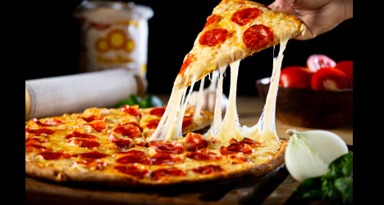

sql data analysis
Pizza sales analysis

Slide 2
Link for tables required in pizza sales data analysis
https://drive.google.com/drive/folders/1lIuRqZka-tfY-ldyVSF6yzm9JFFovb3j?usp=drive_link

Slide 3
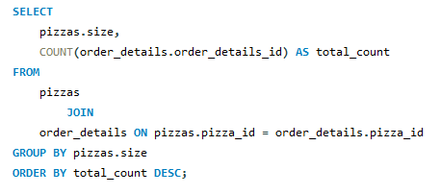
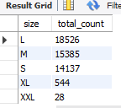
Identify the most common pizza size ordered.

Slide 4
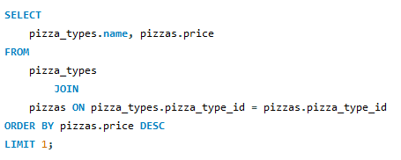

Identify the highest price pizza

Slide 5
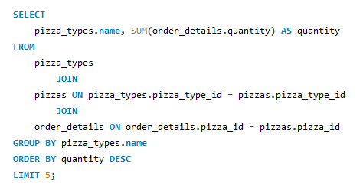
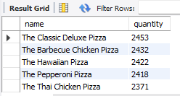
List the top 5 most ordered pizza types along with their quantities.

Slide 6
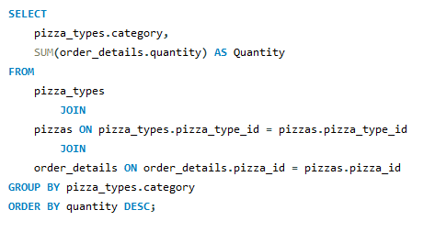
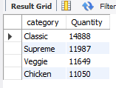
Join necessary tables to find the total quantity of each pizza category ordered.

Slide 7
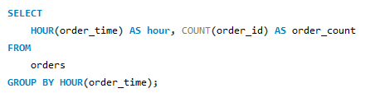
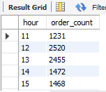
Determine distribution of orders by hour of the day.

Slide 8
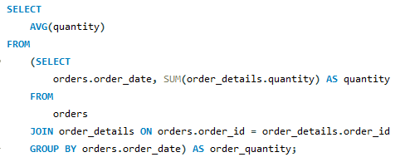

Group the orders by date and calculate the average number of pizzas ordered per day.

Slide 9
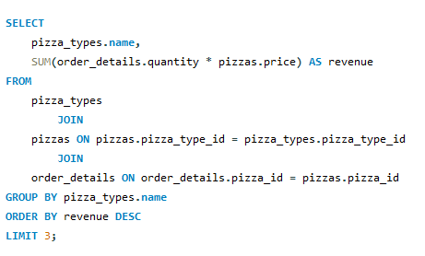
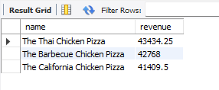
determine the top 3 most ordered pizza types based on revenue

Slide 10
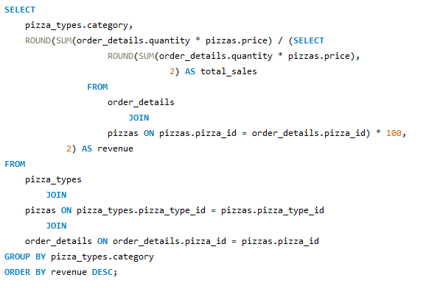
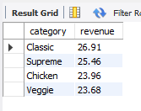
calculate the percentage contribution of each pizza type to total revenue.

Slide 11
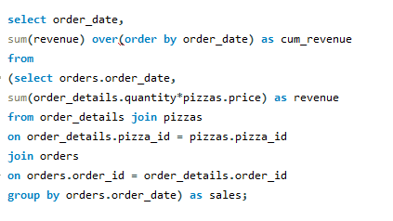
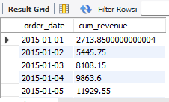
Analyze the cumulative revenue generated over time.

Slide 12
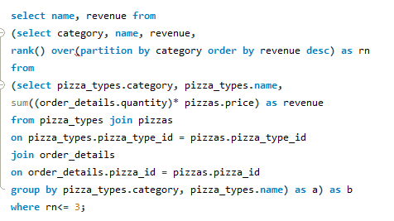
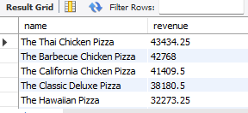
Determine the top 3 most ordered pizza types based on revenue for each pizza category

Slide 13


